Slide 1
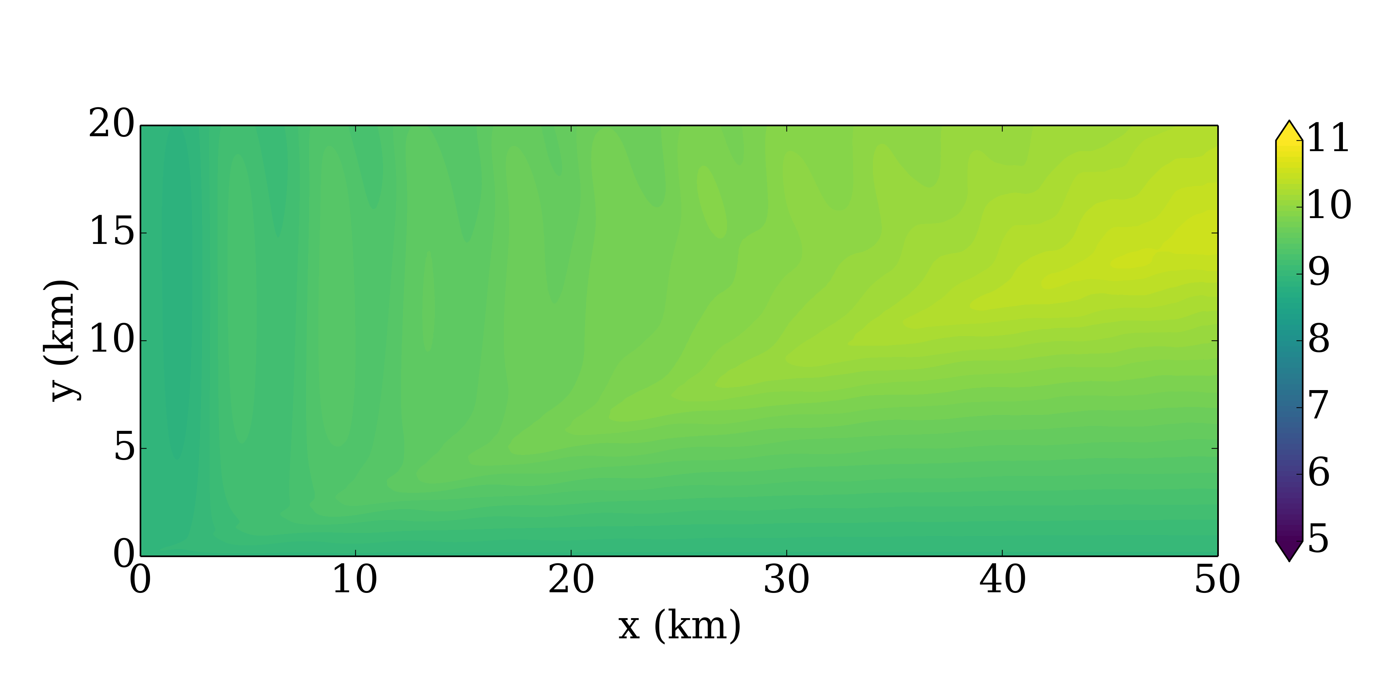
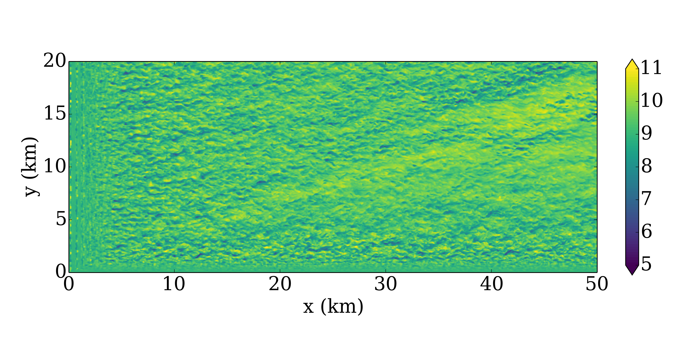
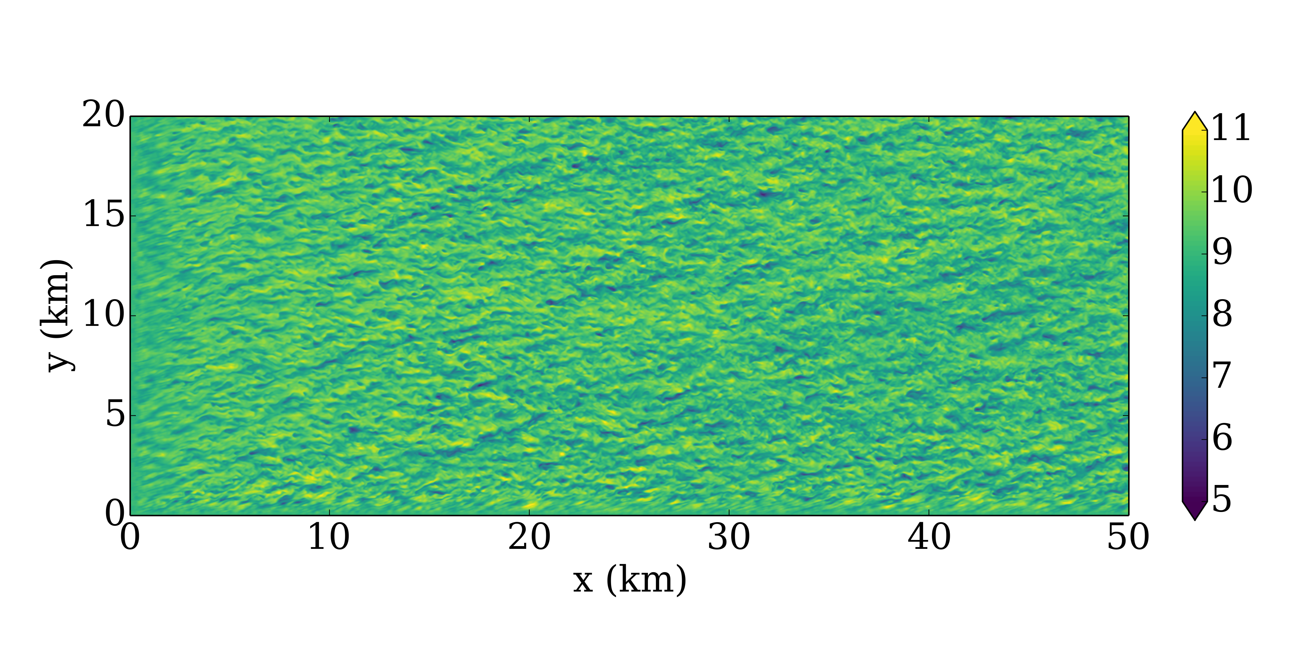
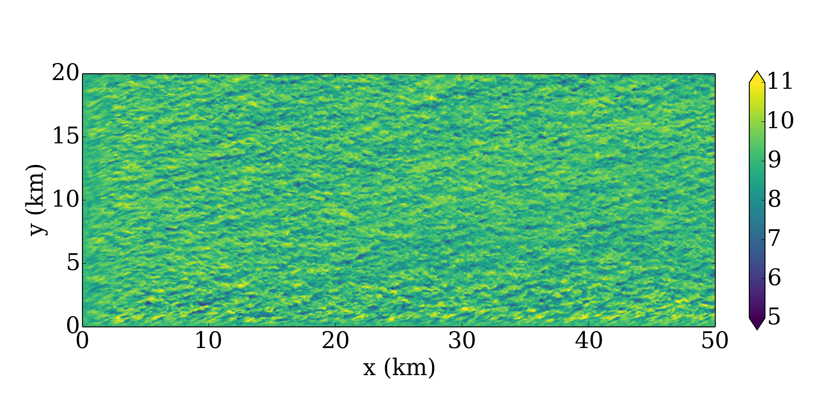
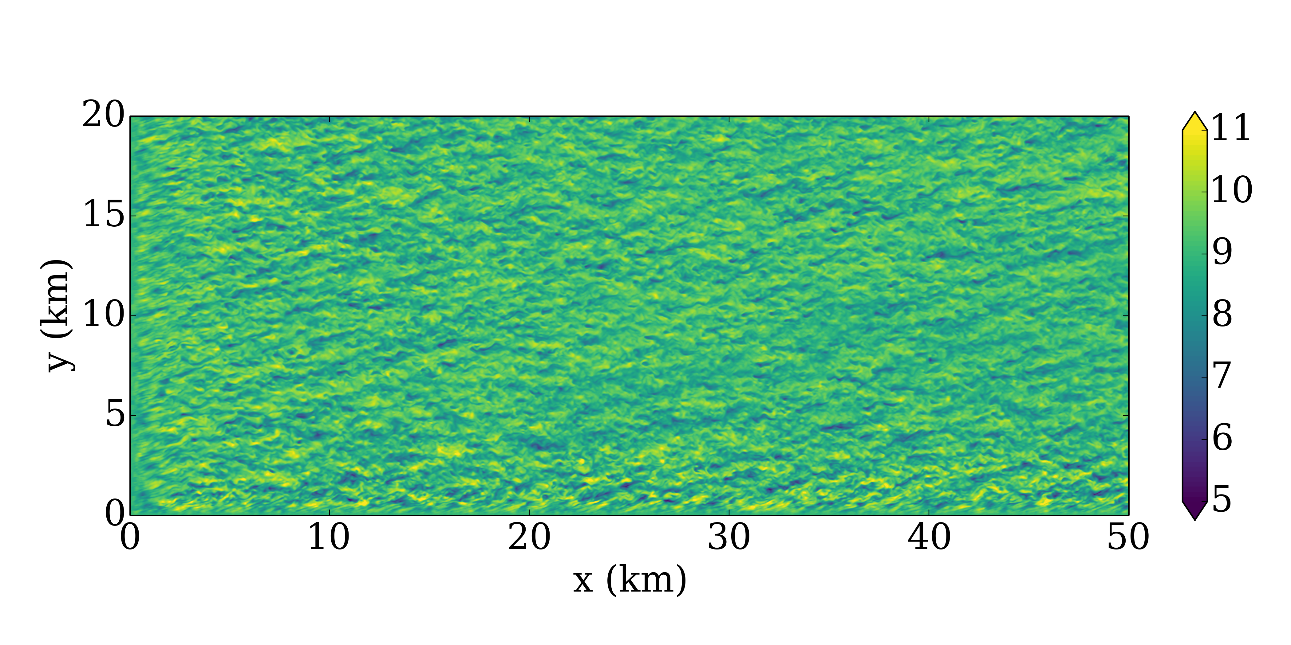
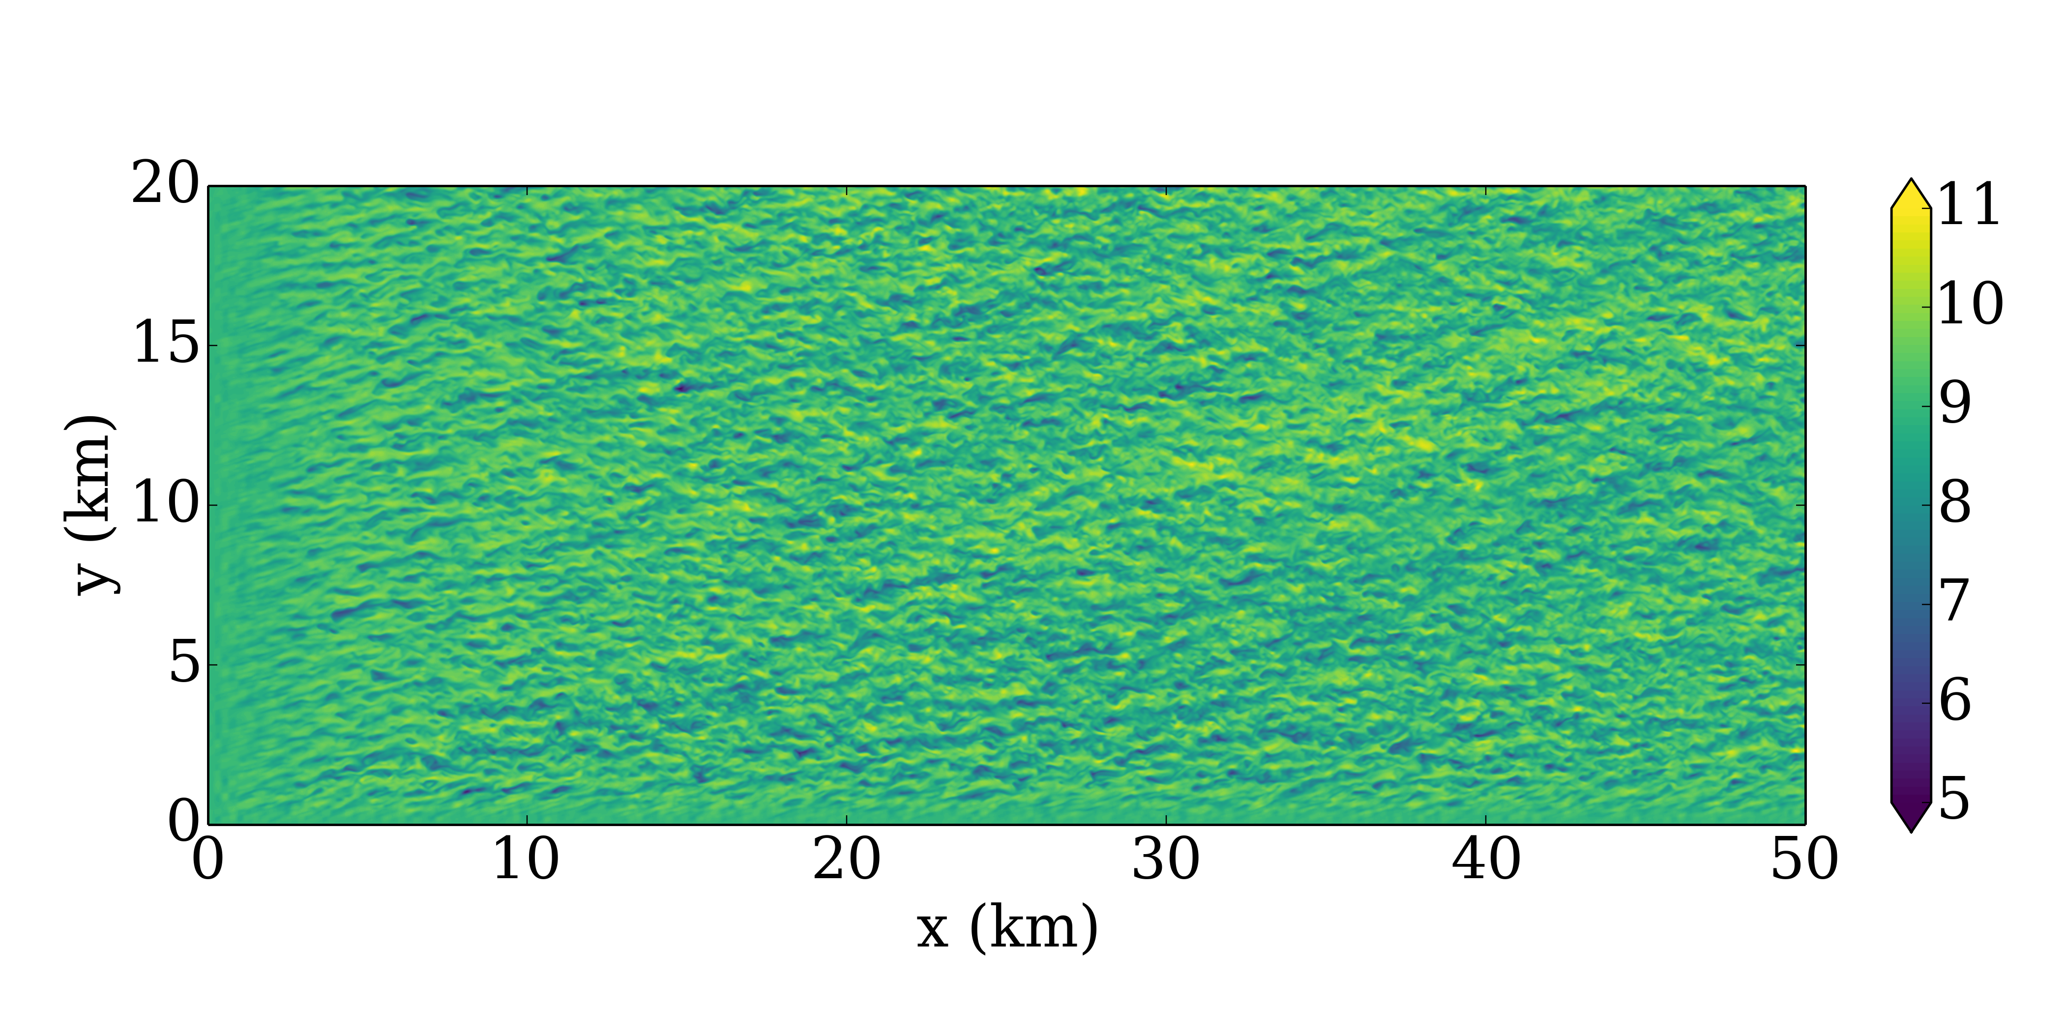
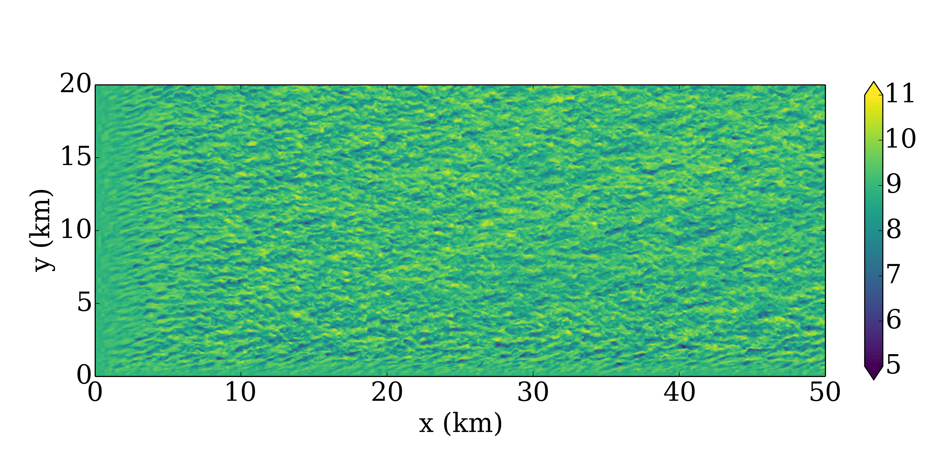
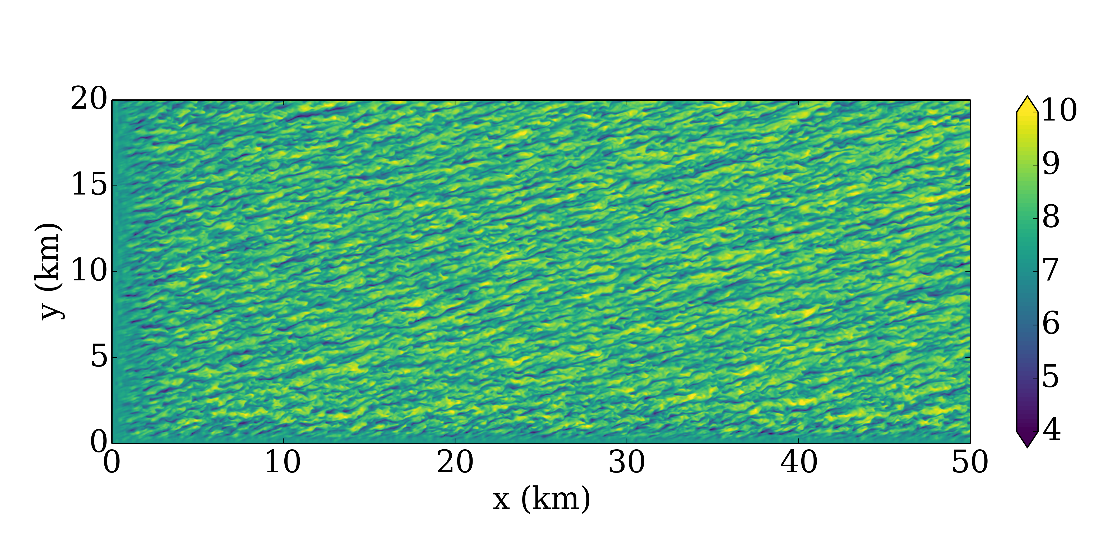
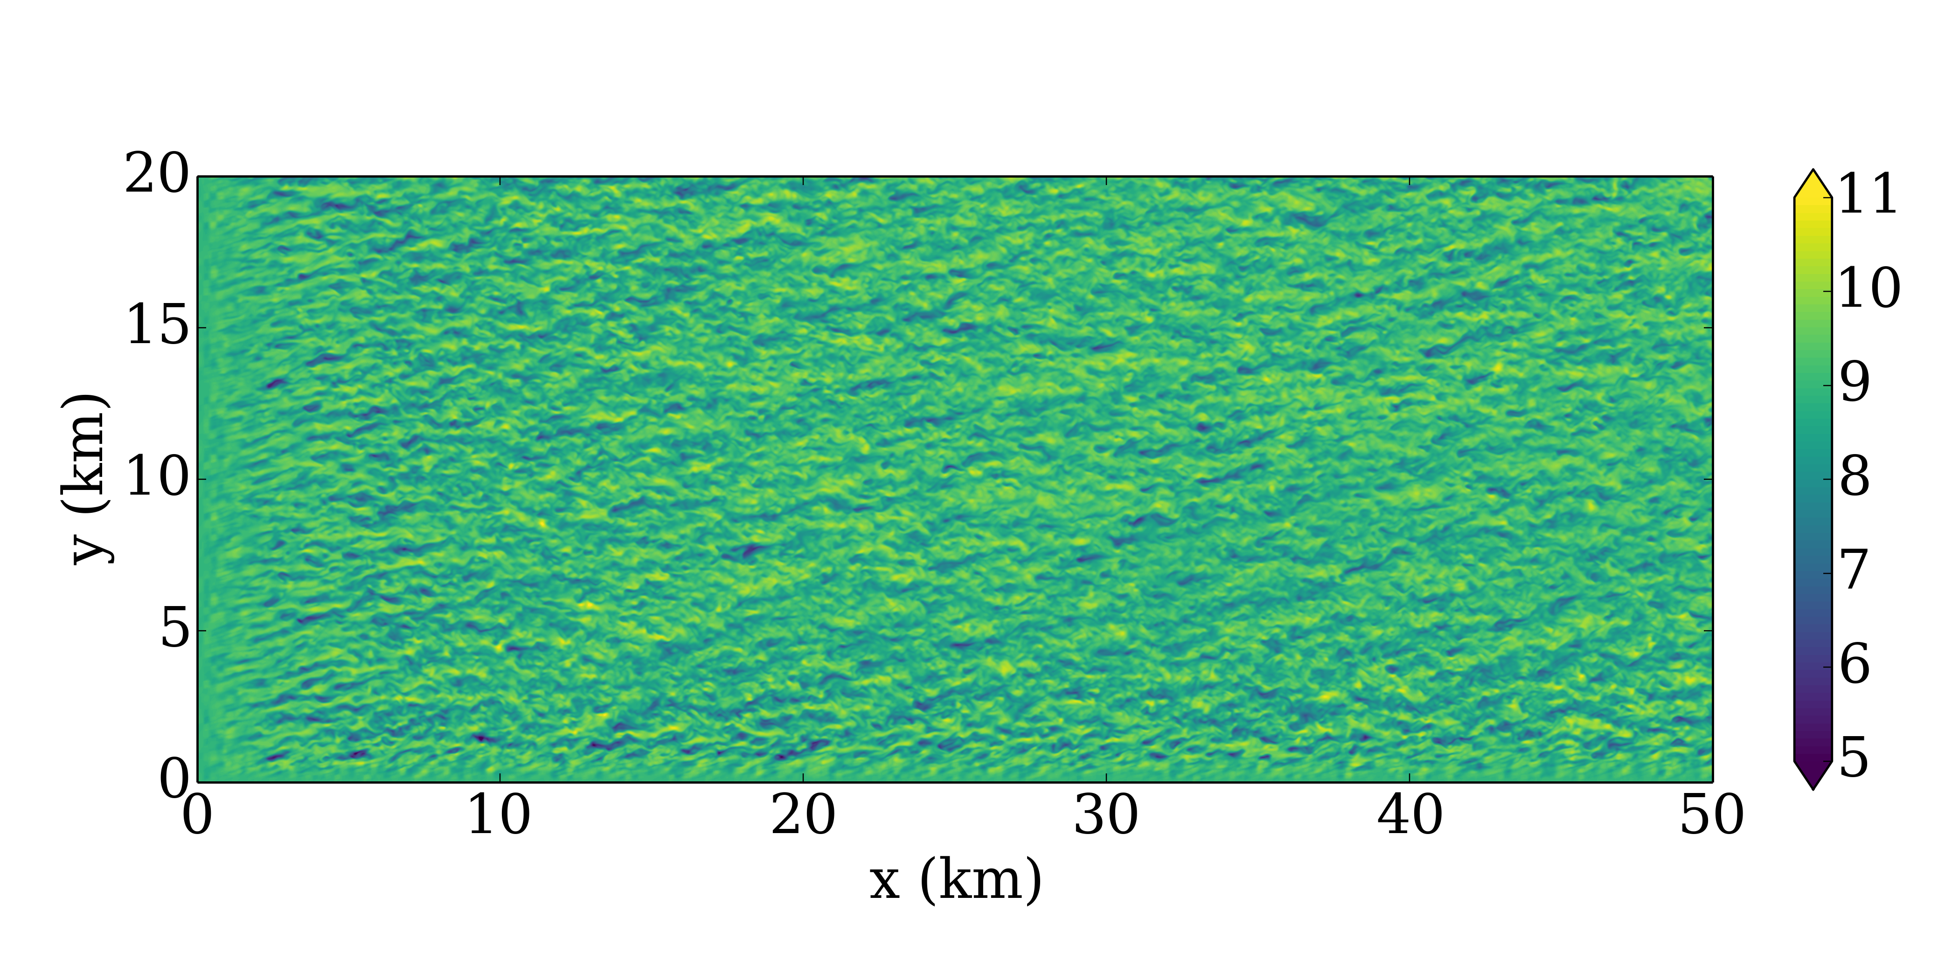
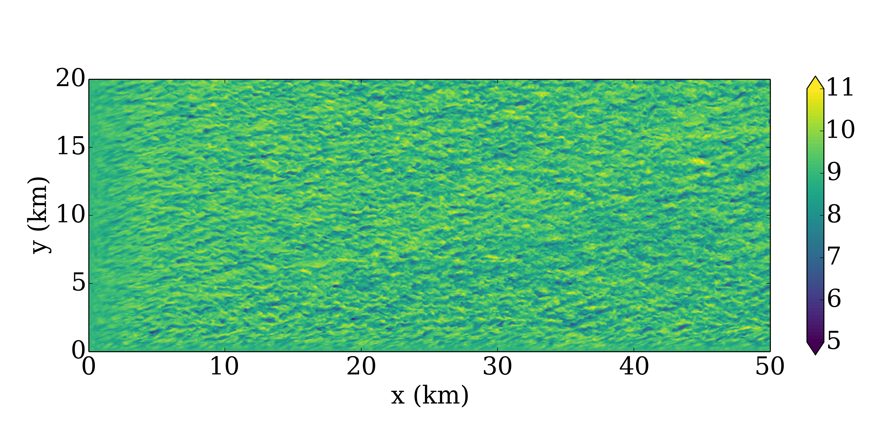
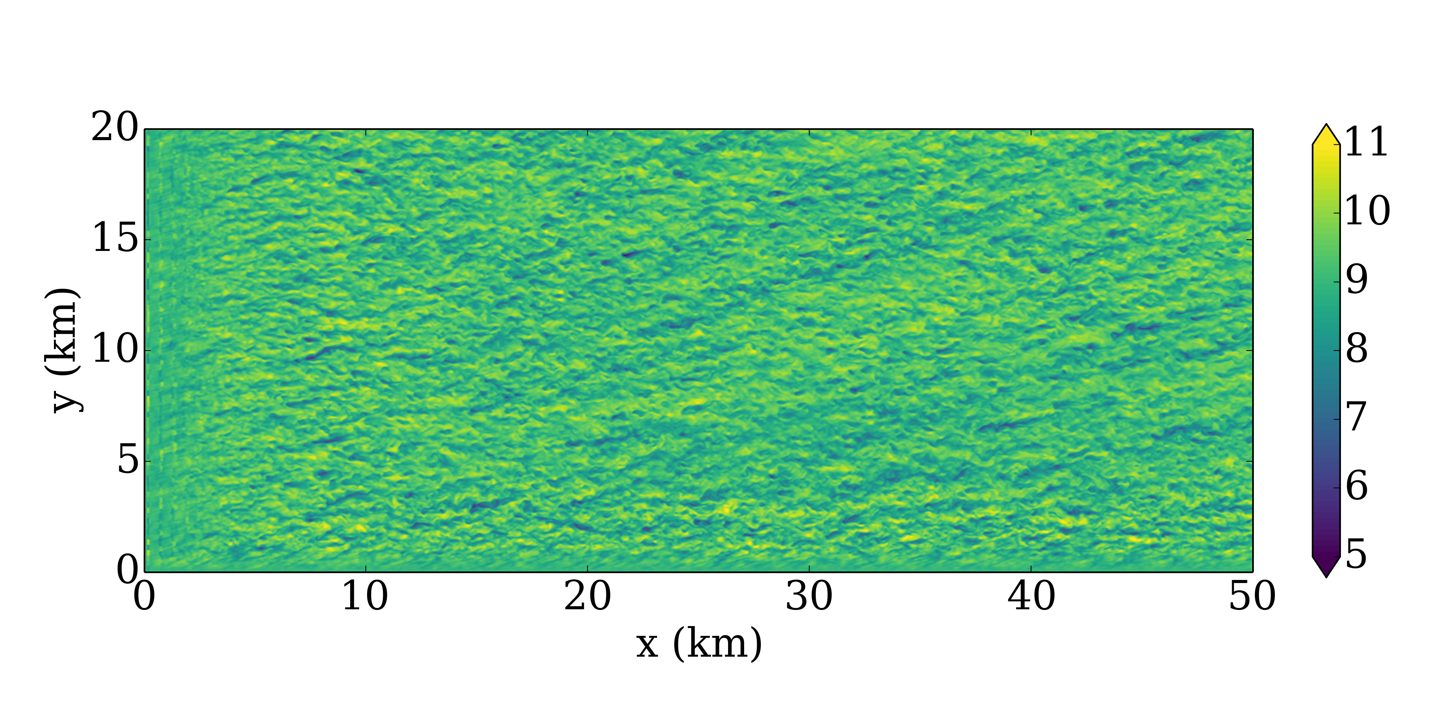
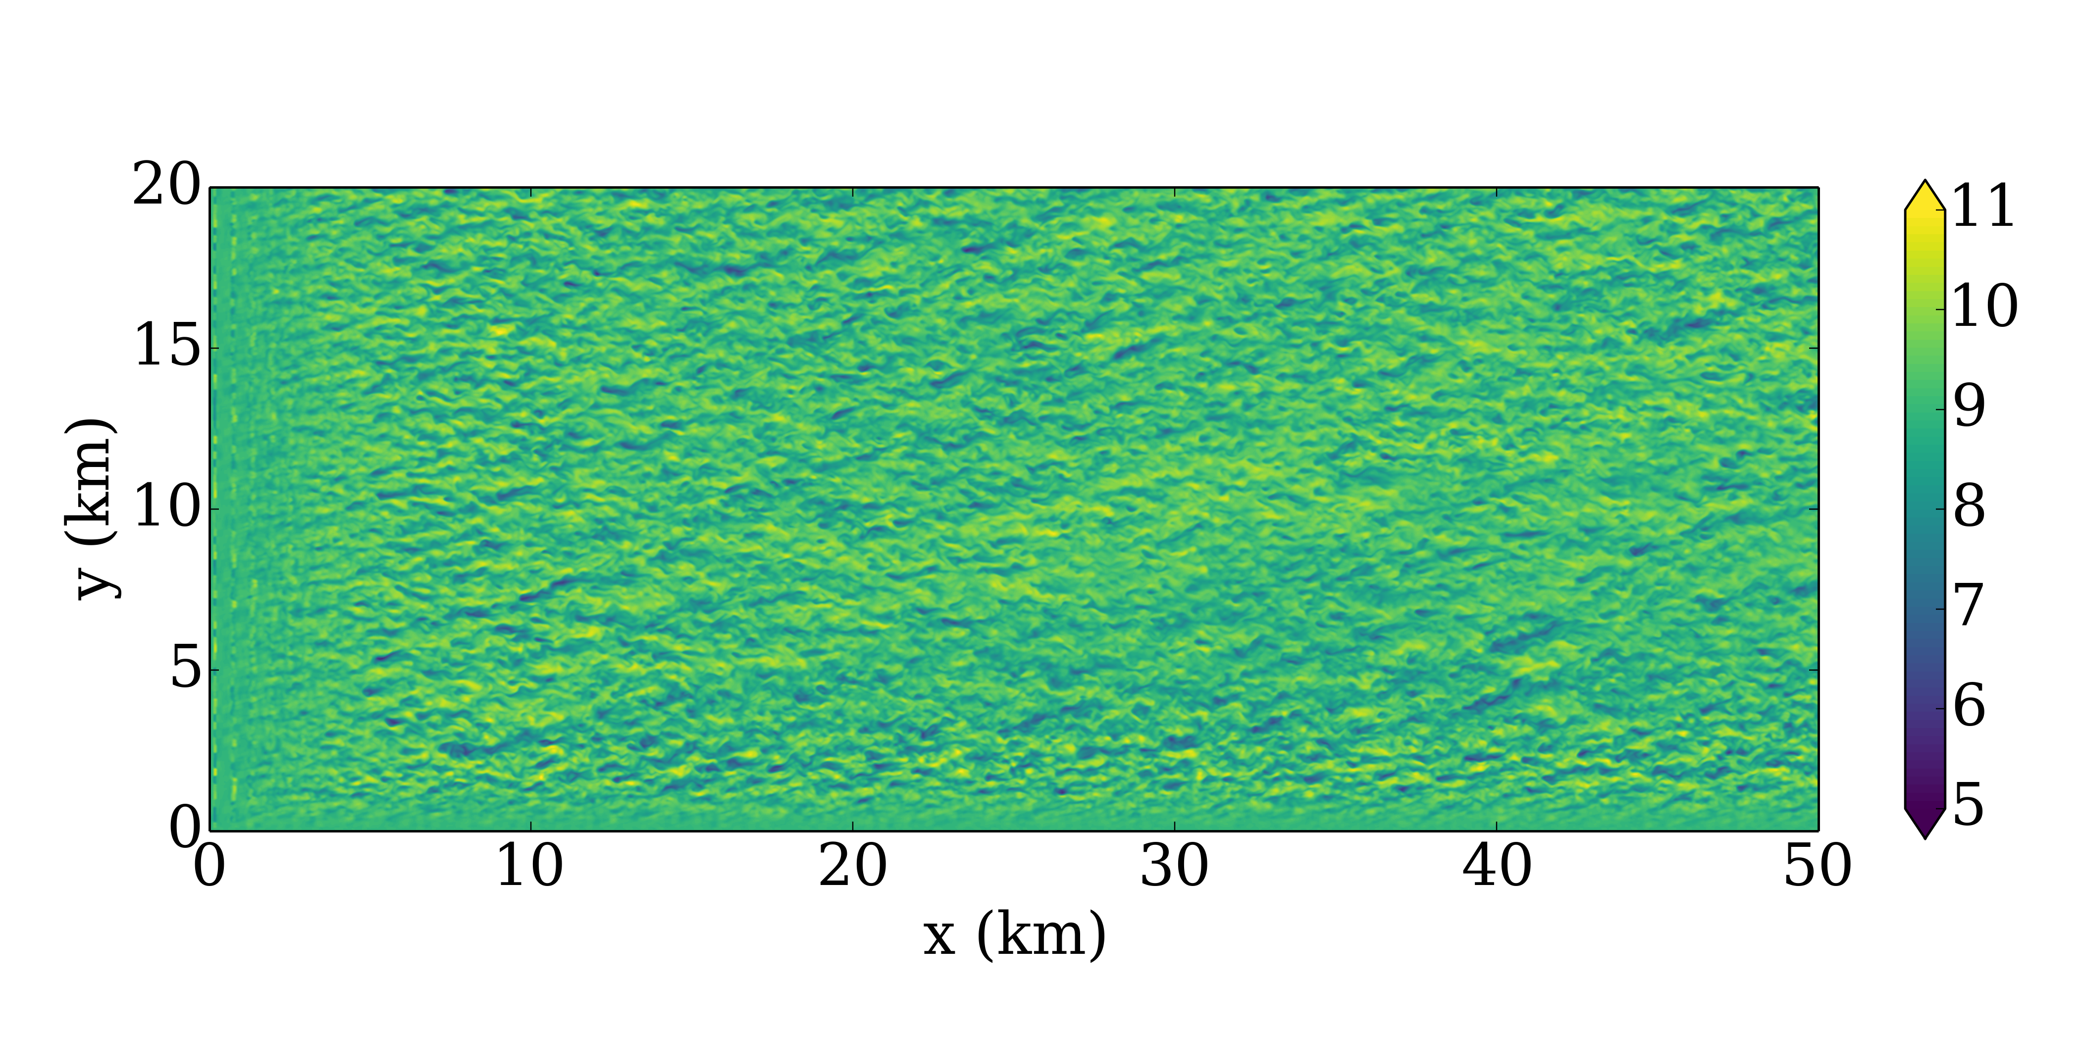
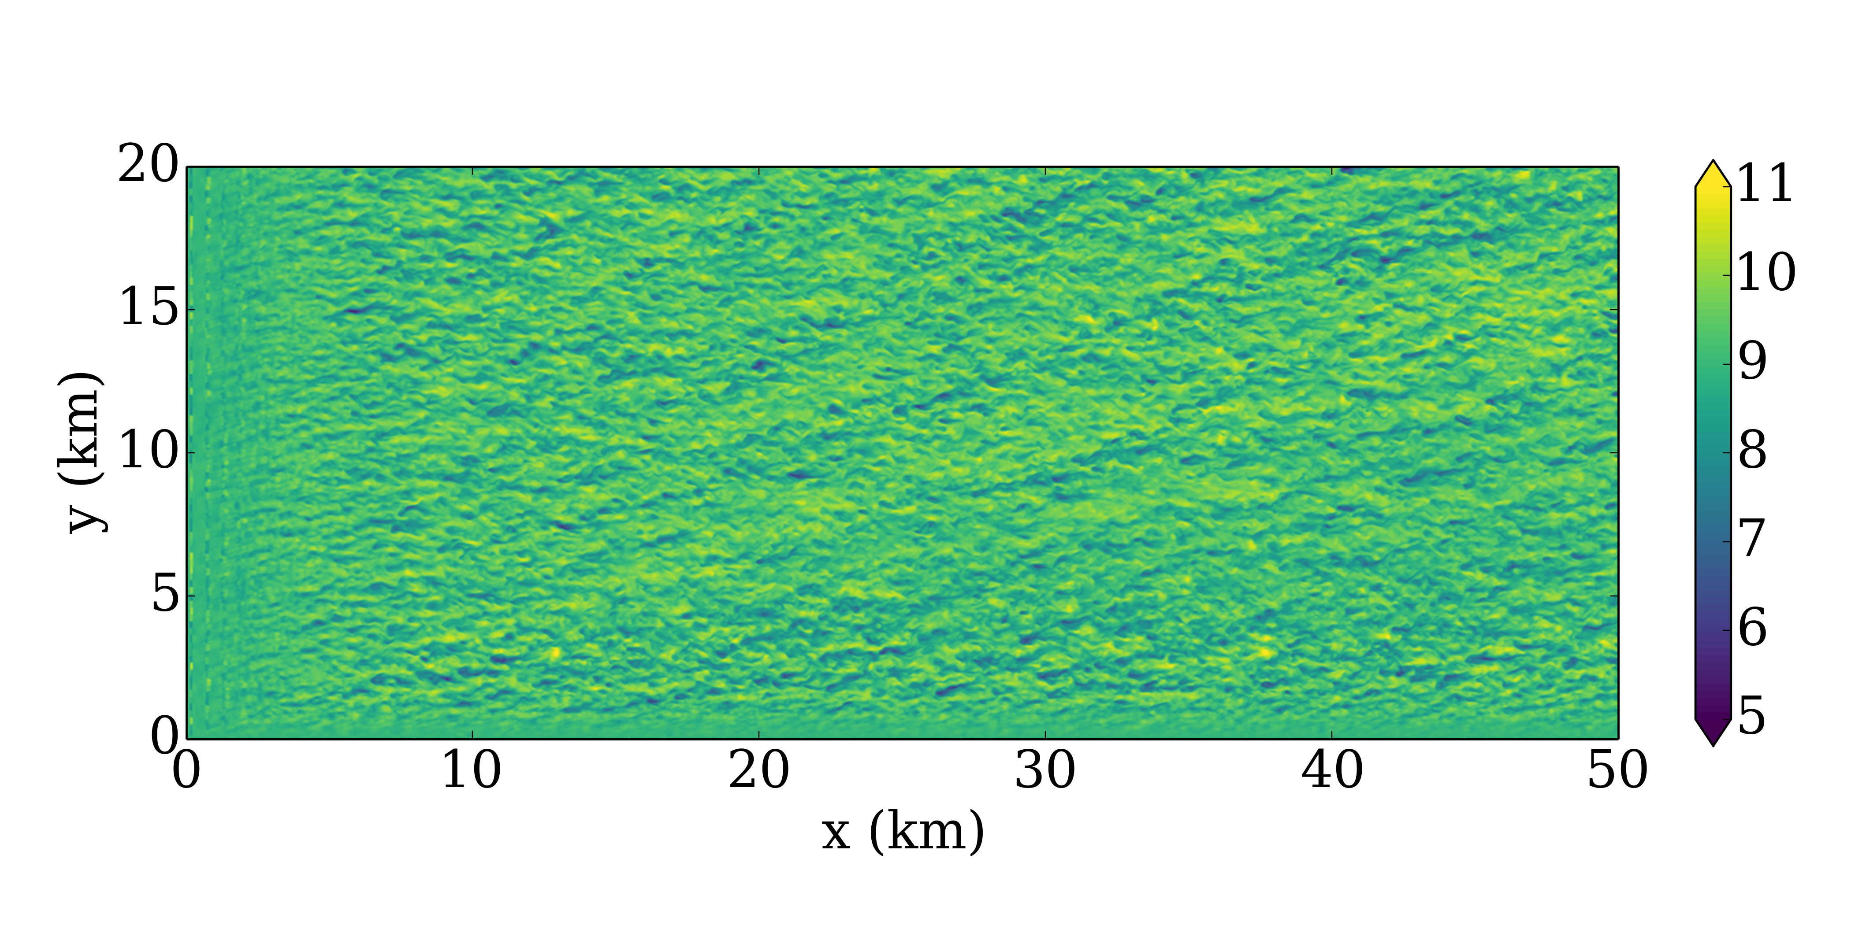
Neutral – z = 250 m
No Perts
θ_{0.5K}
uv₇₅₀
uv₁₀₀₀
uv₁₂₅₀
Uv₁₀₀₀ – New Height
w₁₀₀₀
w₁₂₅₀
w₁₅₀₀
w₁₇₅₀
uv₅₀₀ + w₇₅₀
uv₅₀₀ + θ_{0.25K}
w₇₅₀ + θ_{0.25K}
w₆₅₀ + θ_{0.25K}

